Slide 1
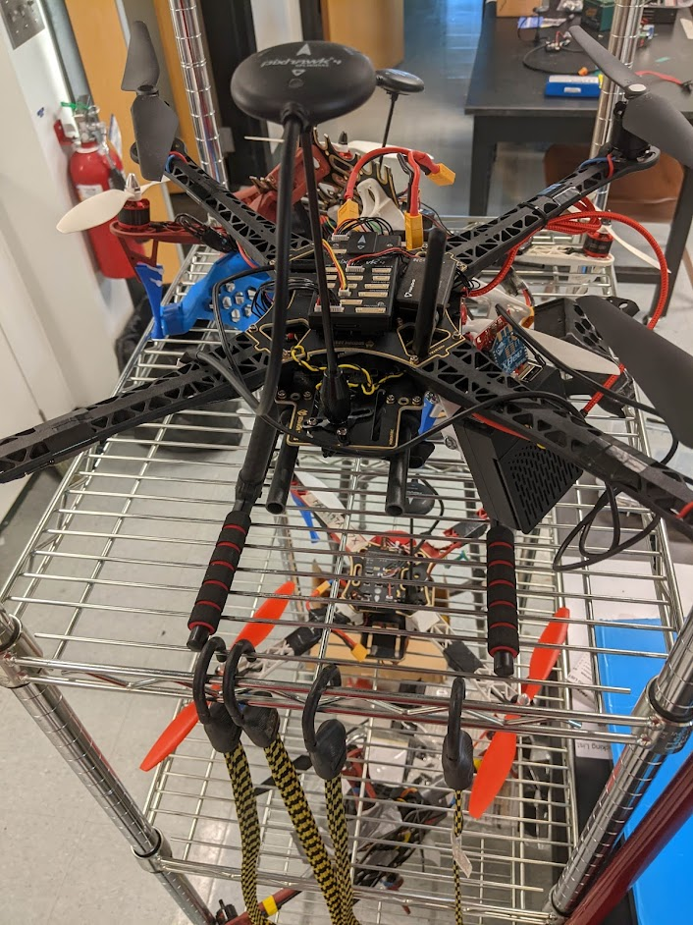

ME740 Final Presentation:
Jetson Adventure!
Object Detection and Tracking for Quads
Ricky Heath
4/28/22

Slide 2
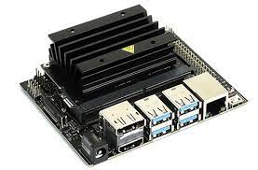
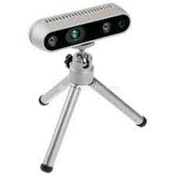
Previously on Ricky vs ROS
Set up Jetson Nano (small AI computer)
Installed ROS Melodic + RealSense D435i camera
Confirmed camera works in ROS RViz
RGB, depth, infrared (1 + 2), and IMU data
SLAM demo available on Wiki
SoftSHell (ssh) to remote into the Jetson from my computer

Slide 3
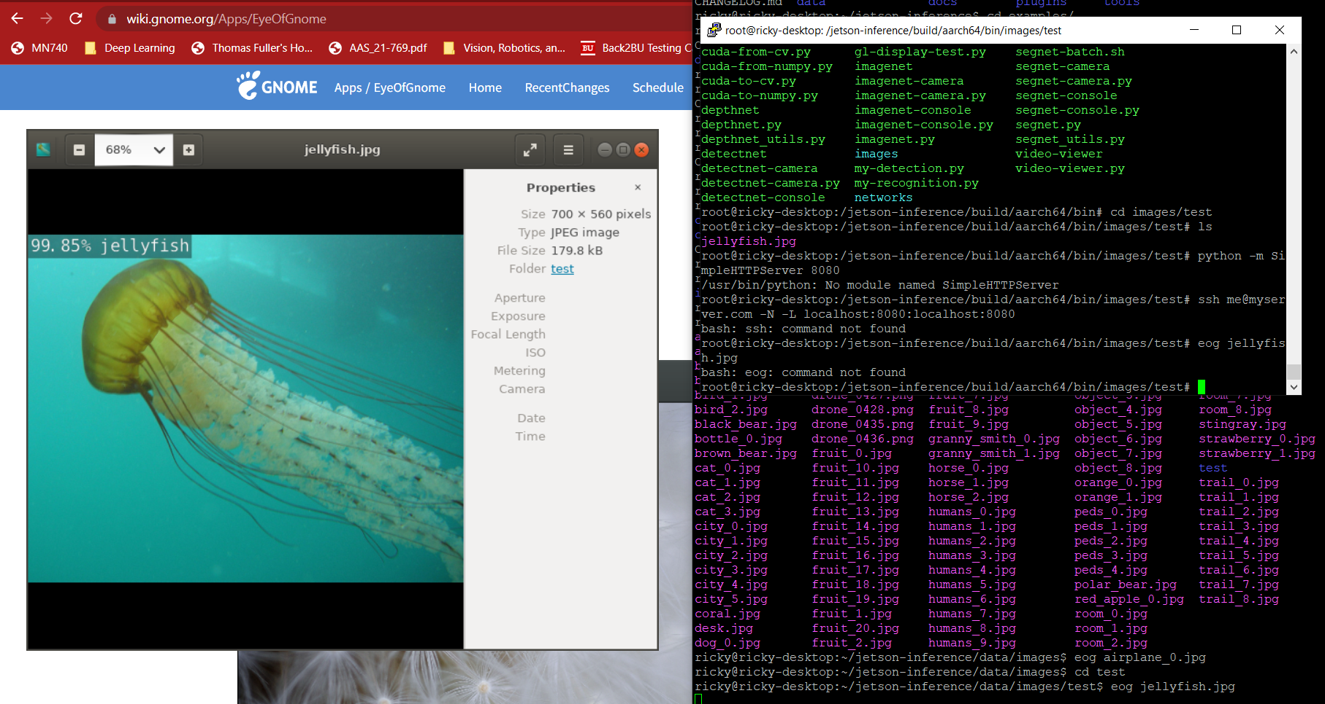
Jetson Inference Features
Imagenet, etc downloaded
Pretrained ML models and image databases
PyTorch downloaded
Can make and train own Machine Learning models!
Can process identify image files with labels
Live object detection in DetectNet demo!

Slide 4
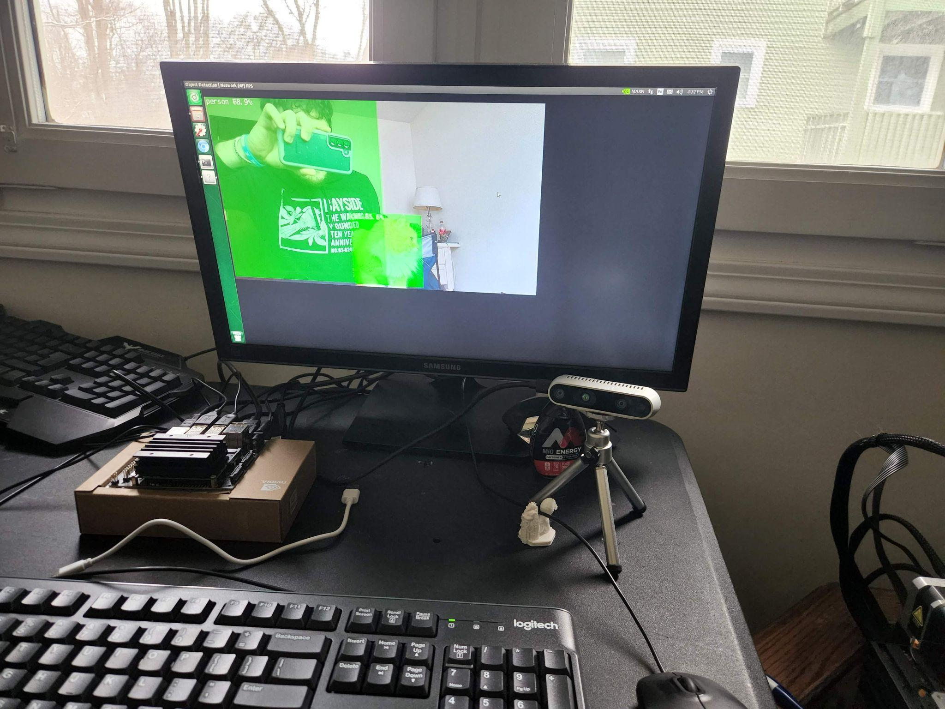
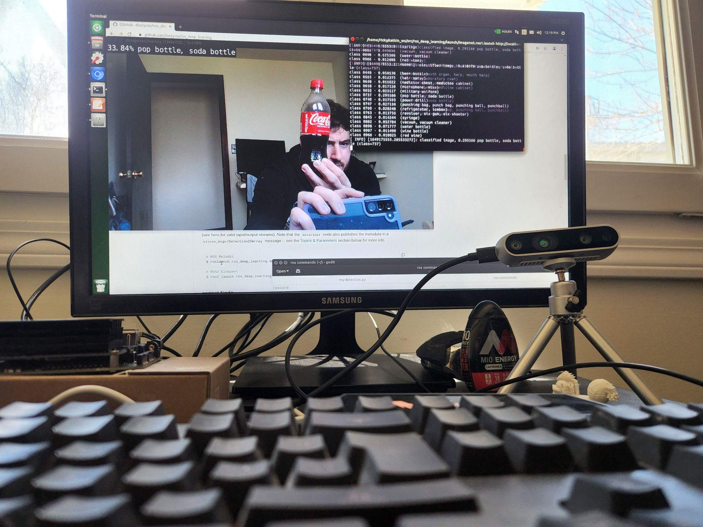
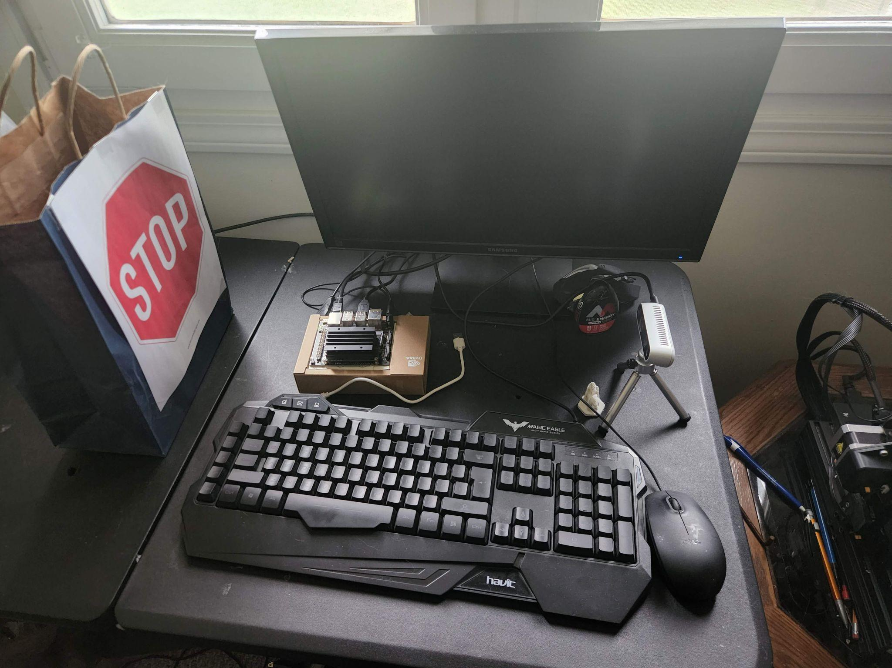
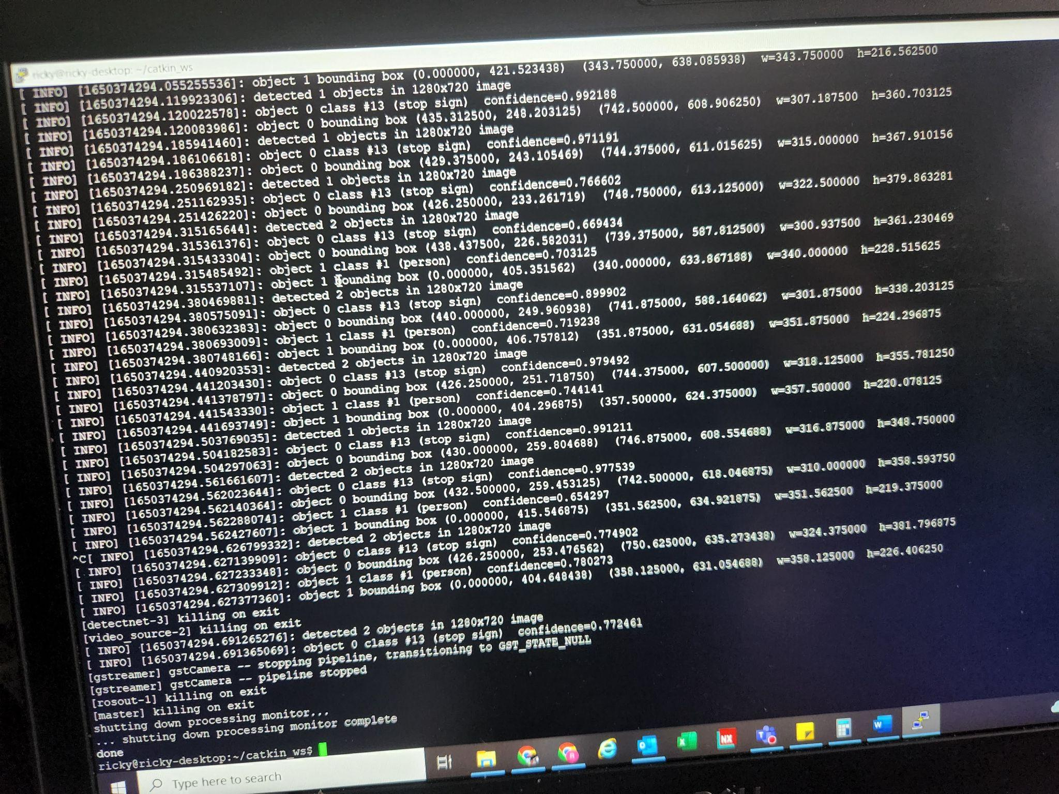
Jetson Inference Tutorial: DetectNet
Detectnet fast, simple, and surprisingly reliable
90 classes in a pre-trained model
Implemented in ROS Melodic
Publishes detection data

Slide 5
Deliverable Goal
Identify target
Stop sign (pretend it’s a landing pad)
Bounding box XY coordinates provided
Get [XYZ] coordinates
Centerpoint
Save them in ROS to pass to pixhawk GPS waypoint system
Start with static, move to dynamic landing pad

Slide 6
Approach
Basis on Jetson Inference Detectnet (Label #13: Stop Sign)
XYZ requires depth and IMU information from D435i camera
Create ROS messenger node (Python script)
Save XYZ waypoint to rosbag file
Can later be converted to .csv or other useful formats
Streamline the above steps with a bash script

Slide 7
ROS Messenger Node (Python Script)
Subscribes to Detectnet output
Subscribes to Depth + IMU outputs
Processes for recognition of object + XYZ coordinates
Publishes new information for another ROS subscriber

Slide 8
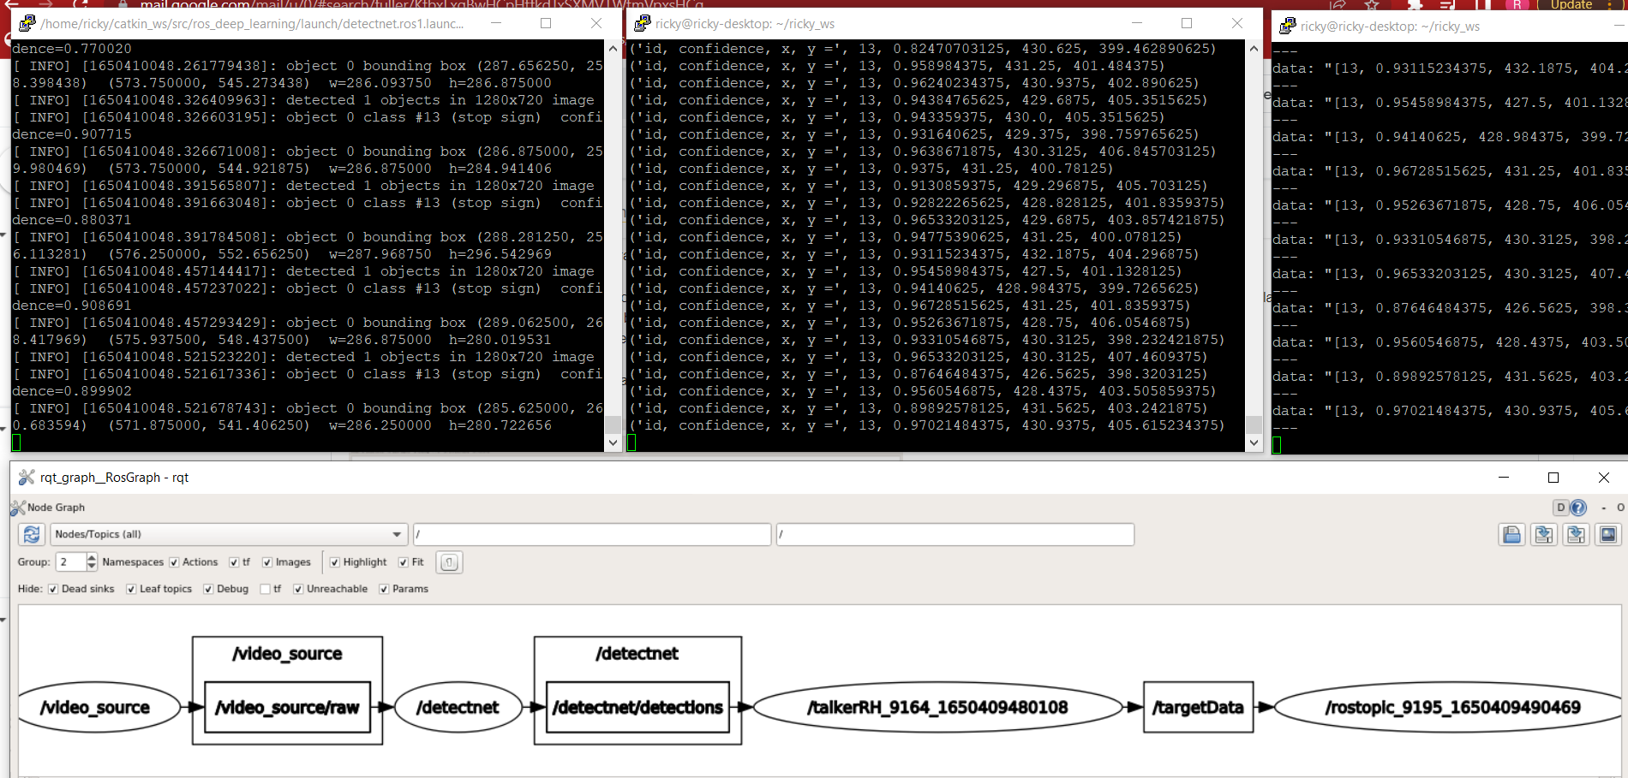
Bash script → ROS commands and Python script → Output

Slide 9
Challenges
Installation + debugging (obsoletion of install files)
Camera IMU was unusable/unreliable
Made SLAM mapping impossible
Common issue in Jetson Nano forums → Mostly unresolved
I could probably spend a whole week debugging this alone
Power + frame rate capabilities of Jetson Nano
Upgraded to barrel jack
Switched to SSH
Still some frame rate warnings
Detectnet demo is fast, but Rviz point cloud output is slow
I was not able to figure out why

Slide 10
Potential Improvements
Improve IMU reliability
Train + work with infrared
Train new model on new target (landing pad, target, etc)
Update everything to ROS2
(not as much support for Jetson devices yet)
I did install ROSbridge, but did not get time to utilize it
Try with more powerful Jetson devices

Slide 11

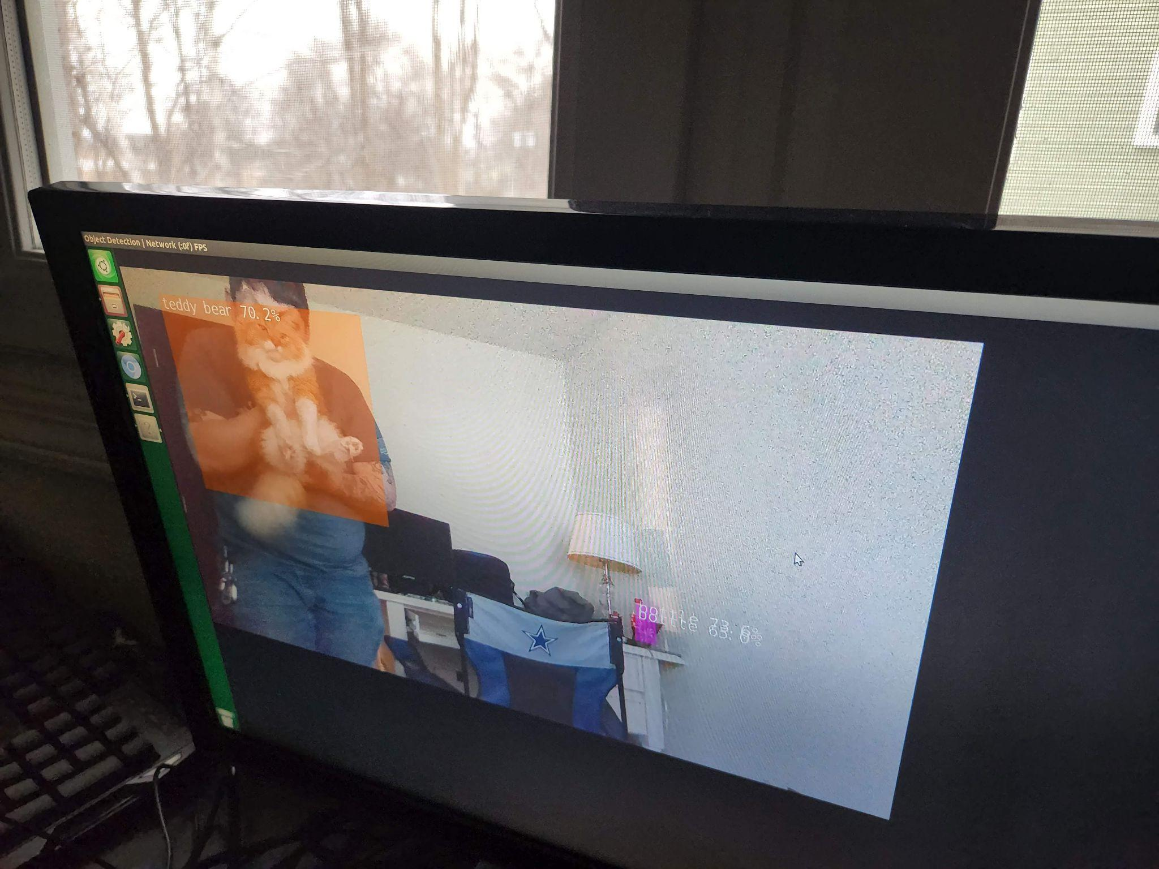
Questions?

Slide 12
Backup Slides

Slide 13
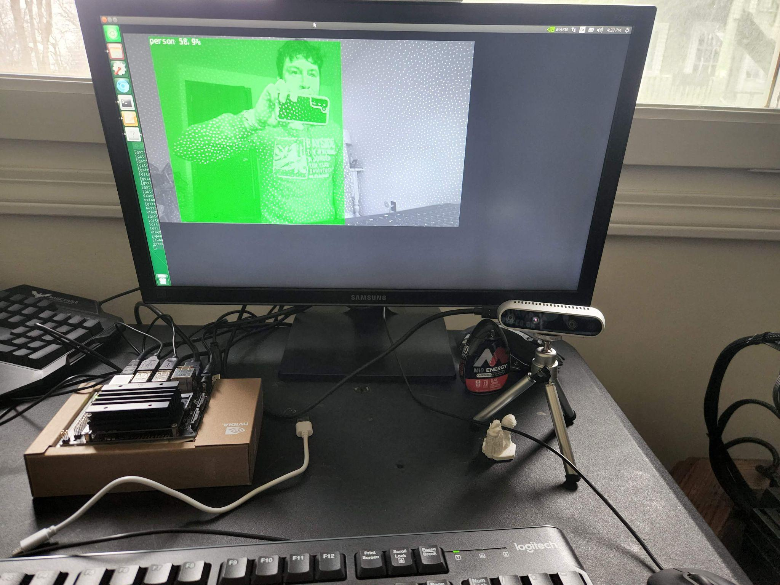
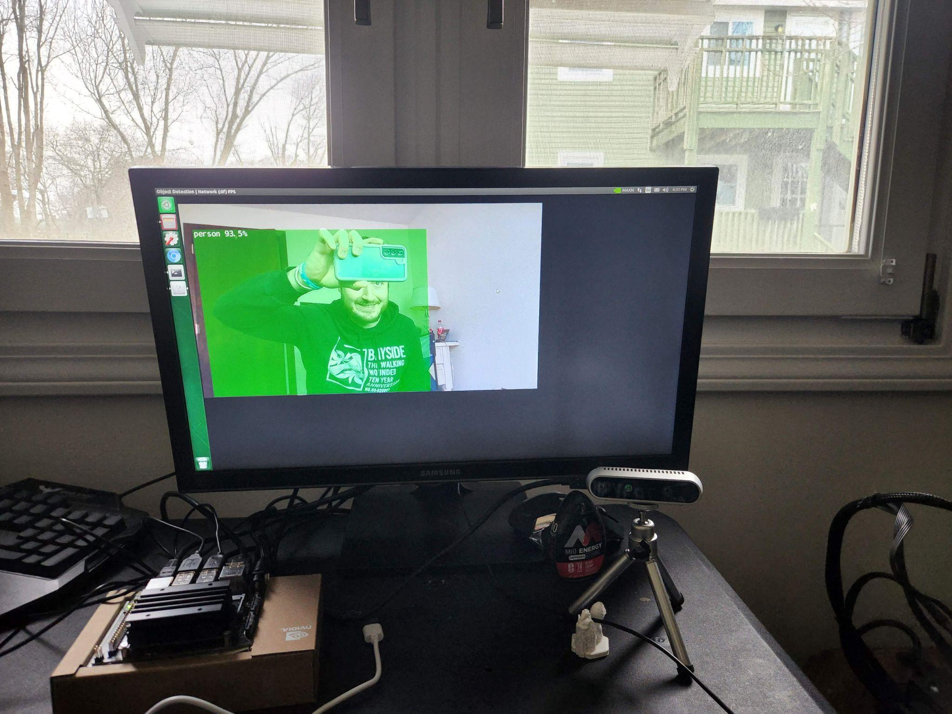
IR (black+white) vs RGB (color) Can you guess which one the model was trained in?

Slide 14
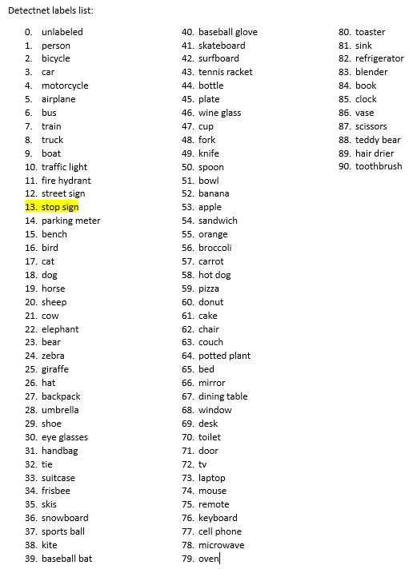

Slide 15
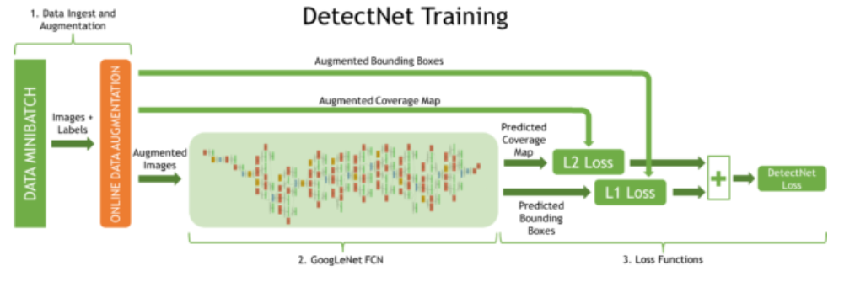
DetectNet Traning Architecture
https://developer.nvidia.com/blog/detectnet-deep-neural-network-object-detection-digits/

